Slide 1

Redux

Slide 2
Content
Definition of Redux
Why REDUX
REDUX Basics

Slide 3
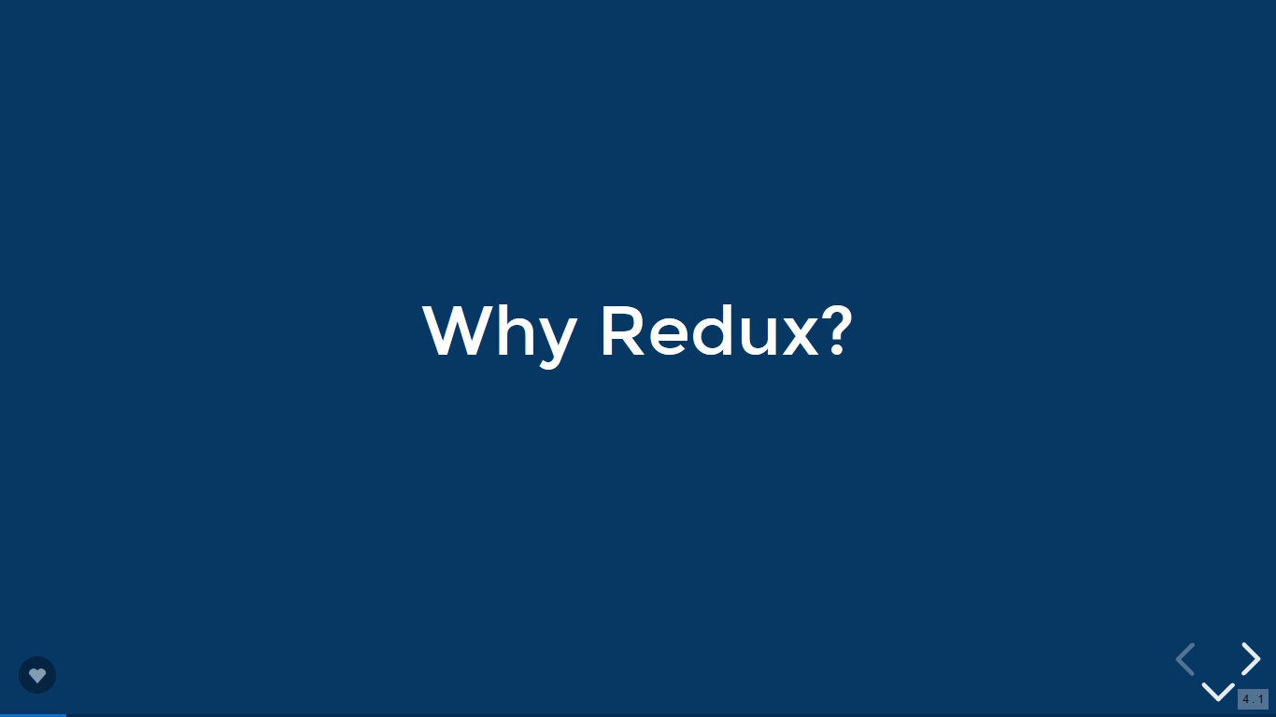
Definition of Redux

Slide 4
What is Redux?
Redux is a tool based on the Flux pattern for managing application state.
Redux has been designed for JavaScript applications

Slide 5
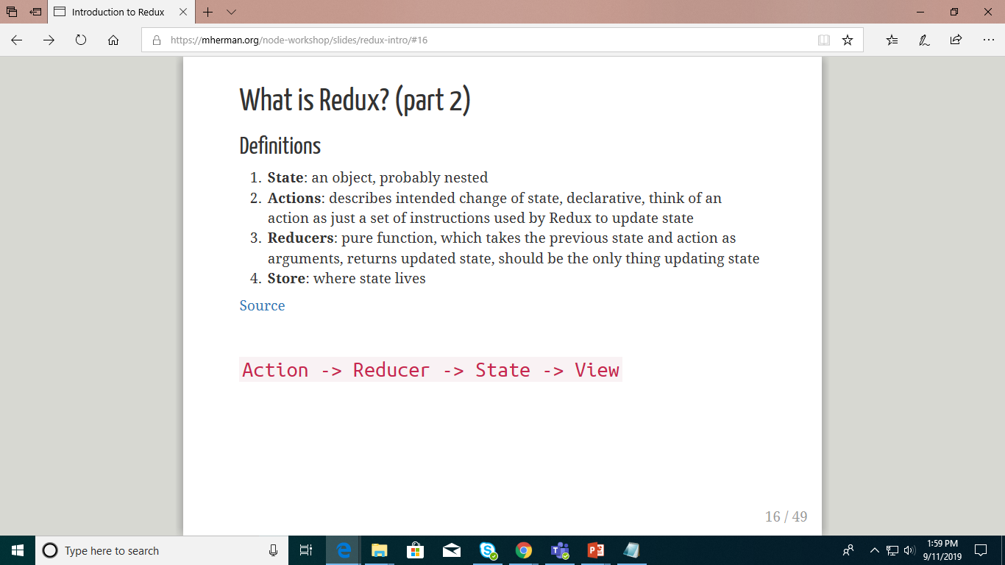
What is Redux?
Definitions
State: an object, probably nested
Actions: describes intended change of state, declarative, think of an action as just a set of instructions used by Redux to update state
Reducers: pure function, which takes the previous state and action as arguments, returns updated state, should be the only thing updating state
Store: where state lives

Slide 6
Why REDUX

Slide 7
Why Redux?
Managing state in JavaScript applications is very challenging
Redux employs a predictable state container to simplify state management
Execution of an application is an initial state followed by a series of actions

Slide 8
Why Redux?
Each action reduces the state to a new predictable state, to which the application user interface transitions
A state container, known as store, contains the reduction logic implemented as pure functions as well as the last reduced (current) state

Slide 9
Why Redux?
As your React app grows, state generally becomes more and more spread out amongst different class-based components. This is messy. Plus, state is tightly coupled with the view logic.
Redux helps to mitigate those issues by managing state in a single place outside of React, promoting-
A single source of truth
2. Separation of concerns

Slide 10
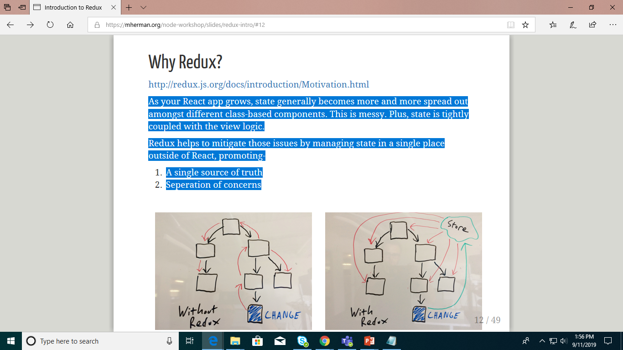
Why Redux?

Slide 11
Three Principles of Redux
To enable state changes to be predictable, the following constraints applied to state changes
Single source of truth: The state of your whole application is stored in an object tree within a single store.
State is read-only: The only way to change the state is to emit an action, an object describing what happened.
Changes are made with pure functions: To specify how the state tree is transformed by actions, you write pure reducers.

Slide 12
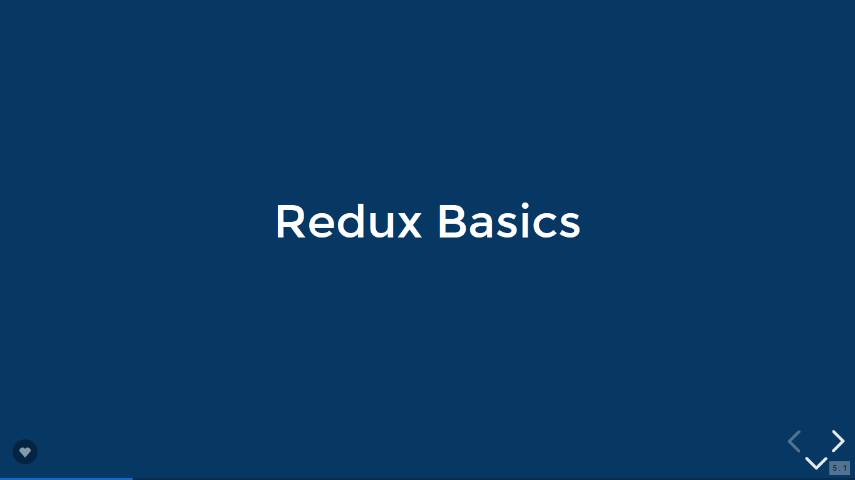
REDUX Basics

Slide 13
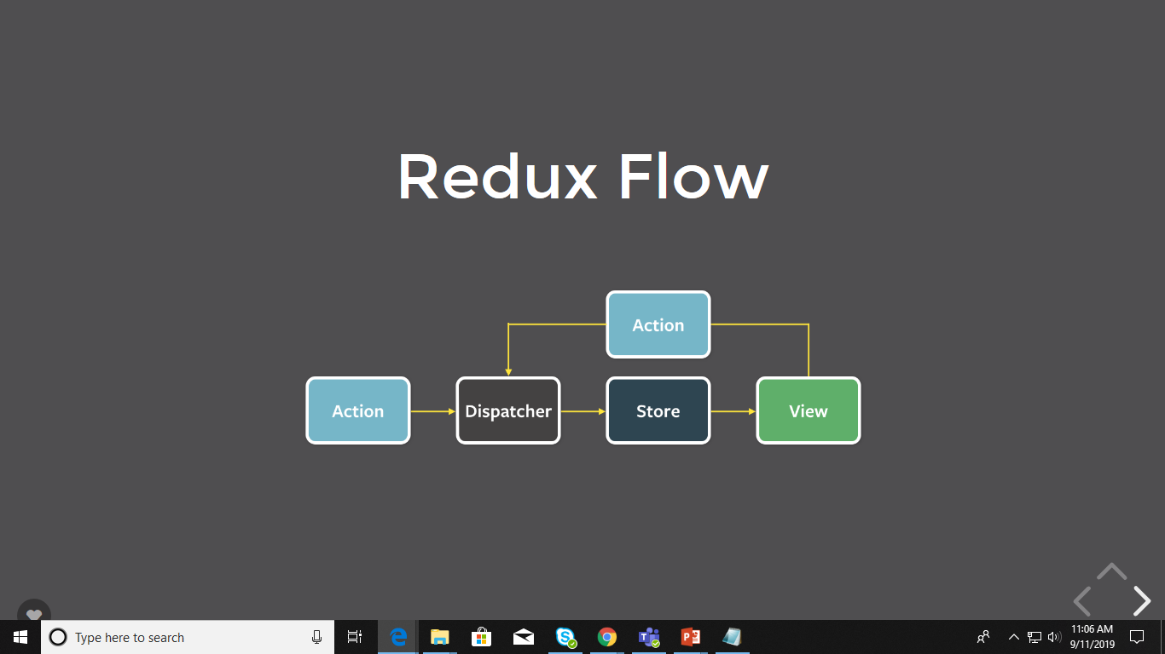

Slide 14
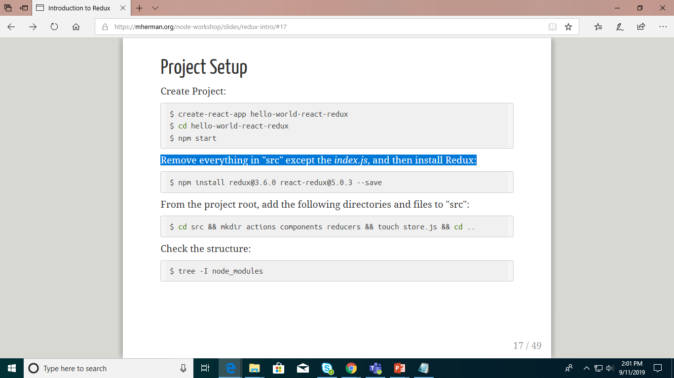

Project Setup
Create Project:
Remove everything in "src" except the index.js, and then install Redux:

Slide 15
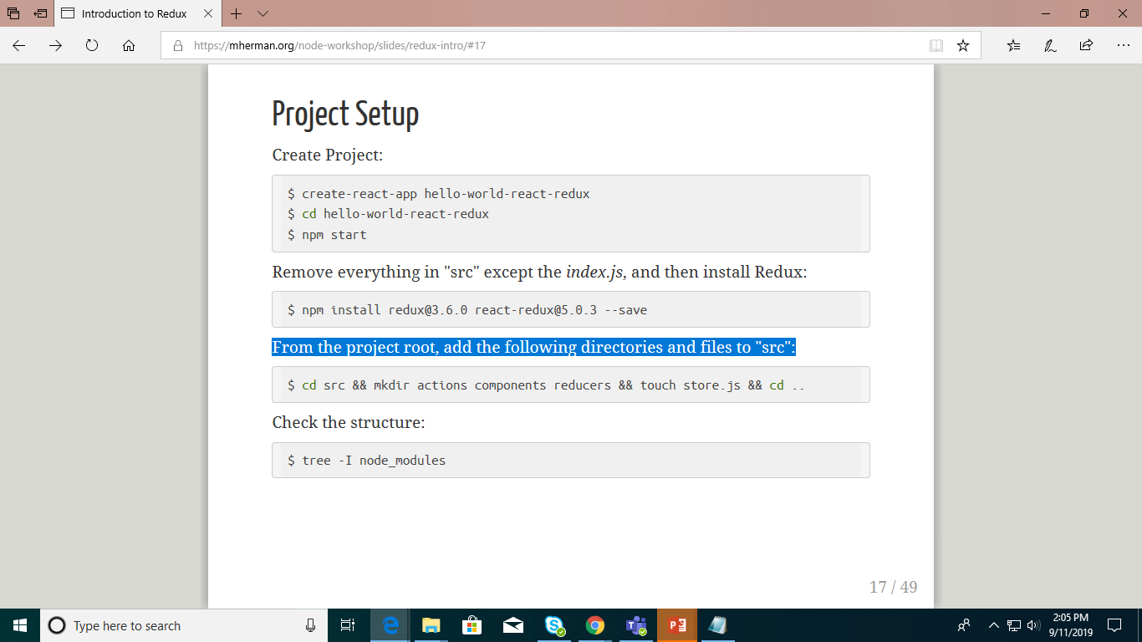
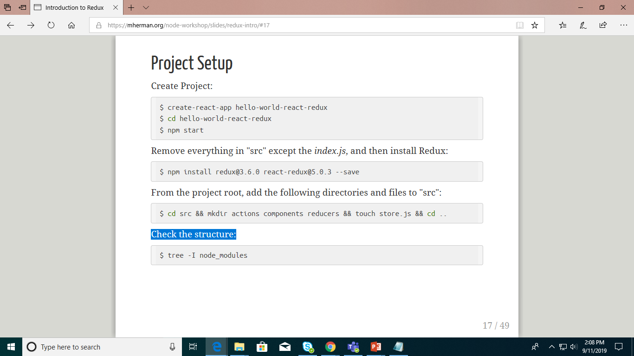
Project Setup
From the project root, add the following directories and files to "src":
Check the structure:

Slide 16
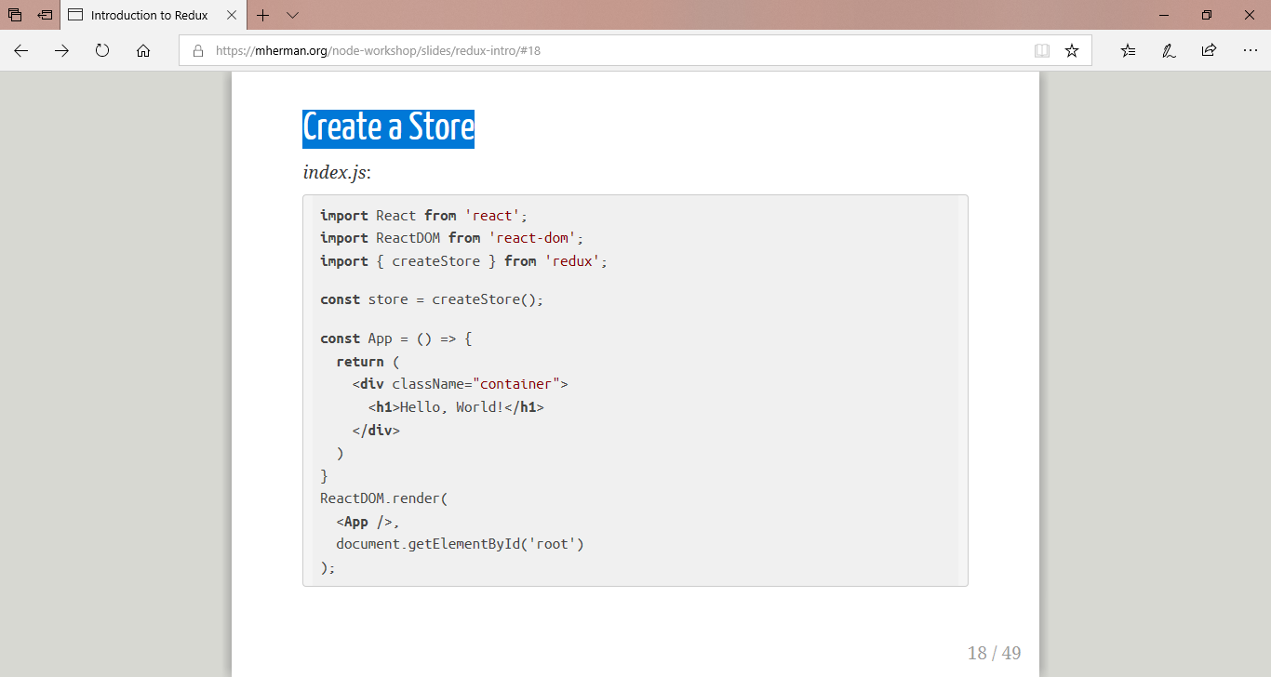
Create a Store

Slide 17
Create a Store
You should see the following error in your browser - Error: Expected the reducer to be a function. Why?
createStore() takes a reducer

Slide 18
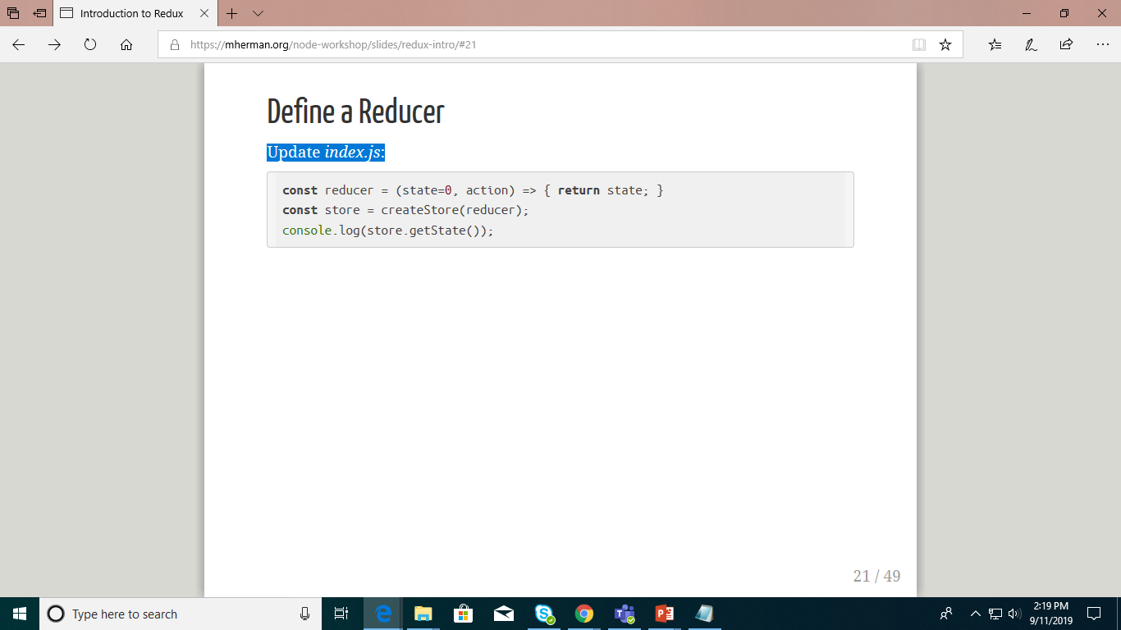
Define a Reducer
Update index.js:
What's happening?
We defined a reducer, which takes the previous state (0) and an action (which we have yet to define) and returns a new state (0).
The reducer is then passed as an argument into createStore, setting the initial state of the app.
Now we can add an action to update state...

Slide 19
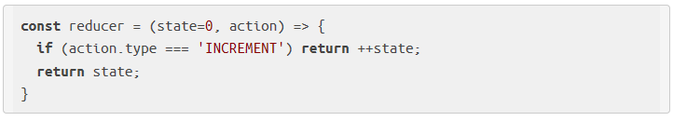
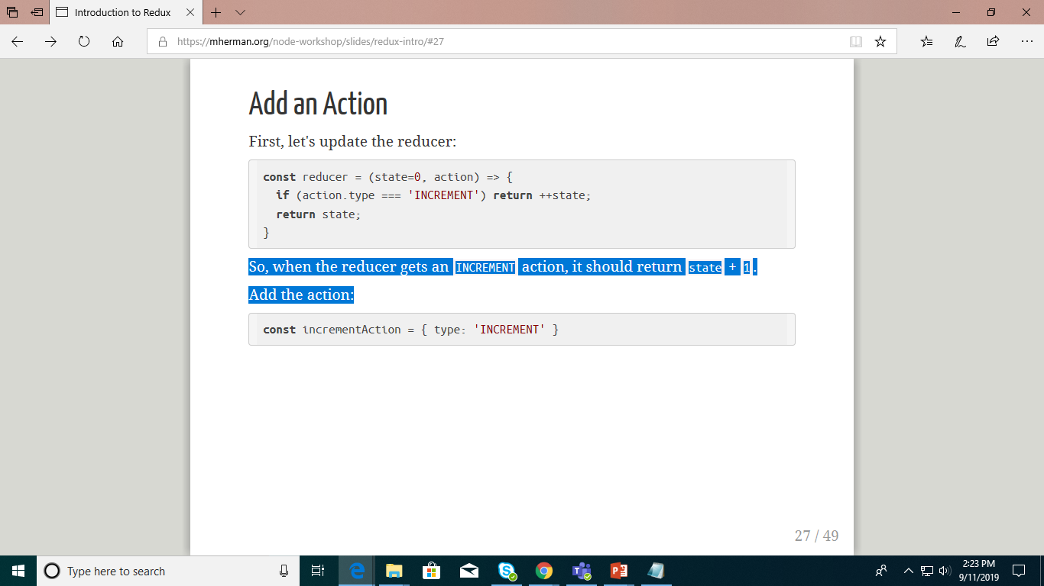
Add an Action
First, let's update the reducer:
So, when the reducer gets an INCREMENT action, it should return state + 1.
Add the action:

Slide 20
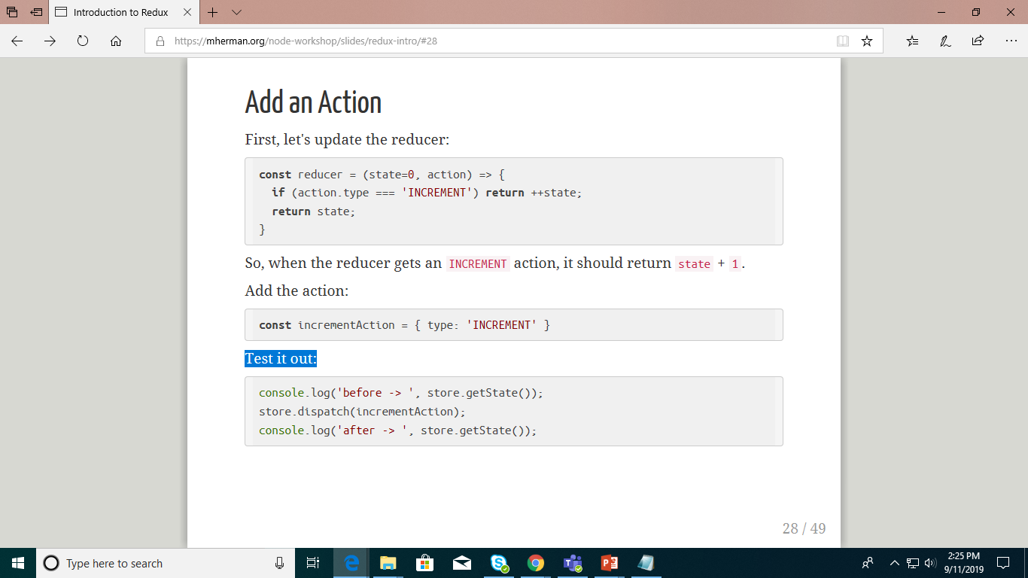
Add an Action
Test it out:
The dispatch() applies the action to the store so that the state is changed.
YOUR TURN! Add a DECREMENT action...

Slide 21
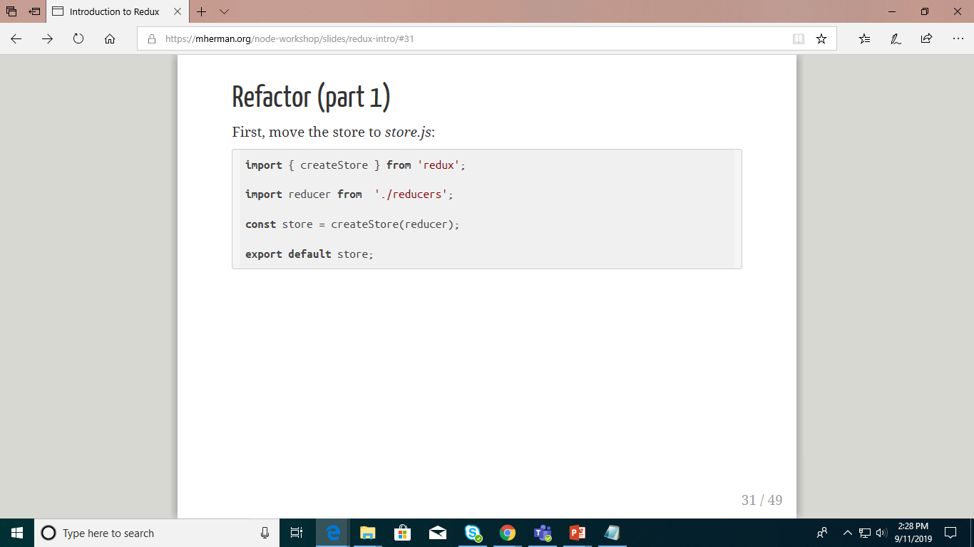
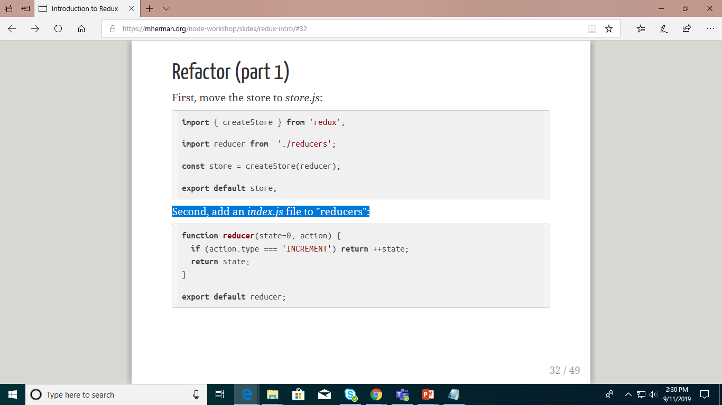
Refactor
First, move the store to store.js:
Second, add an index.js file to "reducers":
To test, remove the store and reducer definitions from index.js and add in the import - import store from './store'.

Slide 22

Refactor
Next, an index.js file to "actions":
Remove the action from index.js and add the import - import incrementAction from './actions'. Test it out!
YOUR TURN!
Update your code to handle the DECREMENT action.
Review the code with your neighbor, adding in comments as necessary.

Slide 23
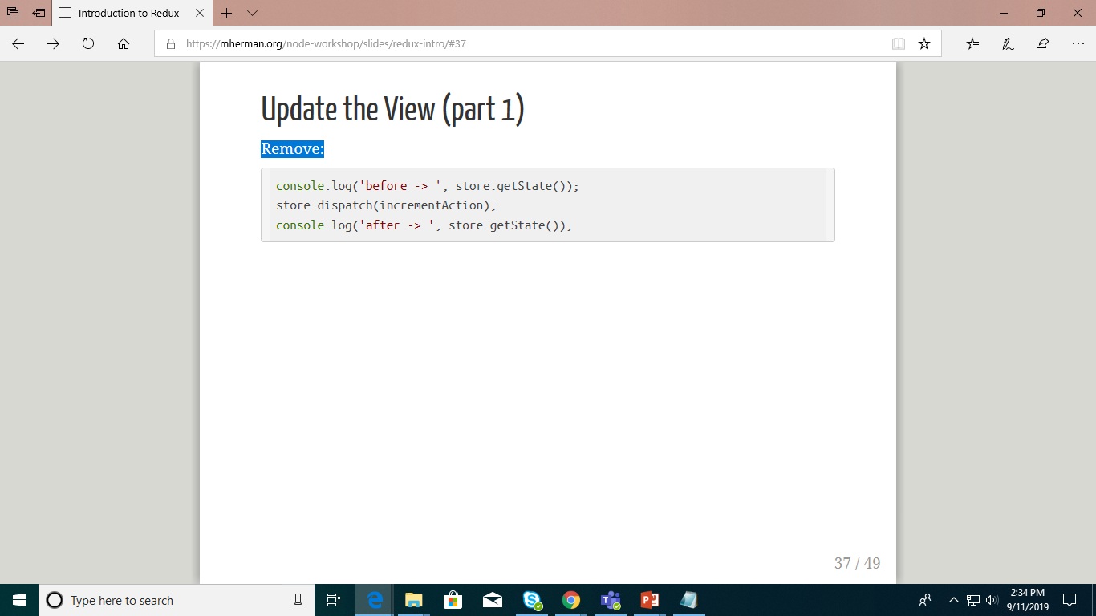
Update the View
Remove:

Slide 24
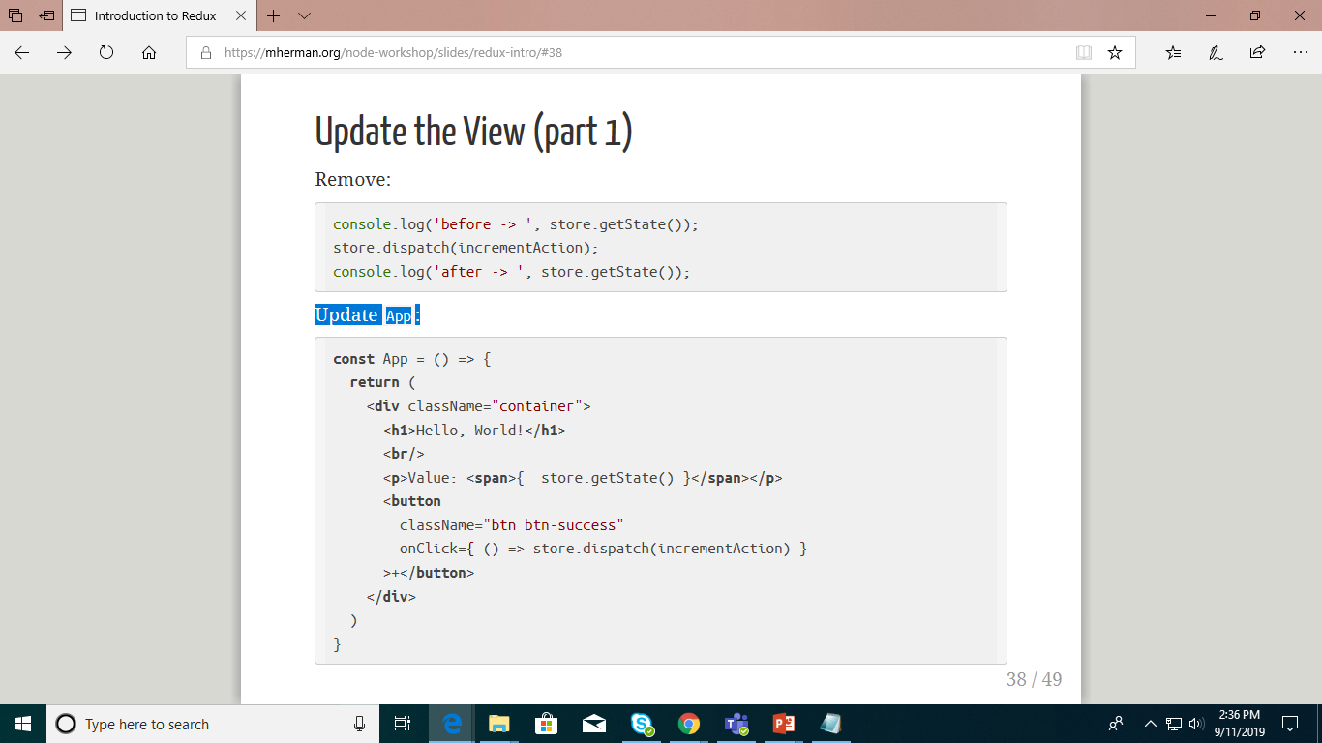
Update the View
Update App:
YOUR TURN! You've seen this all before. Review it with your neighbor.

Slide 25
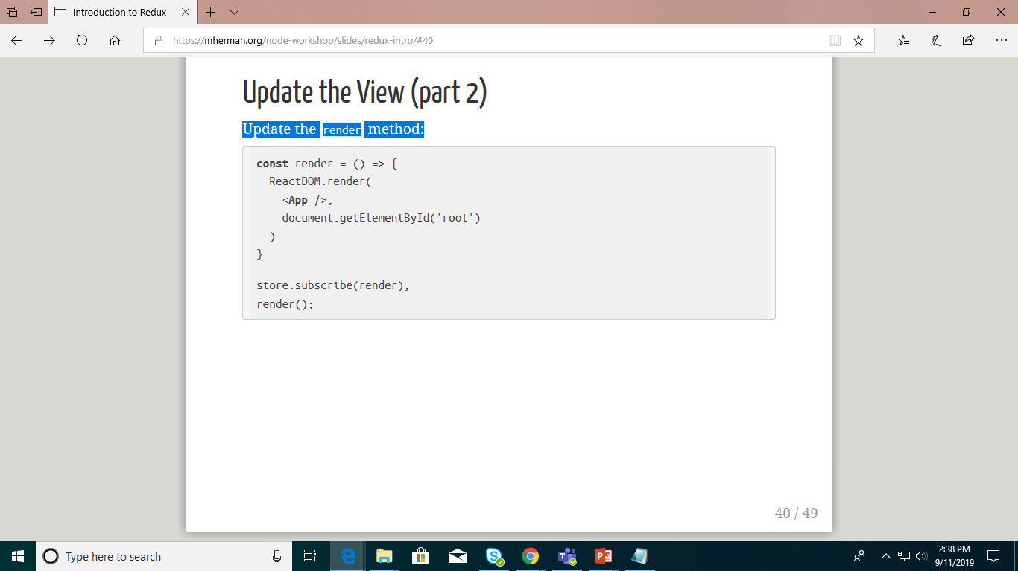
Update the View
Update the render method:
What's happening?
We wrapped ReactDOM.render() in a function aptly named render
render() is added as the store via subscribe - which listens for changes any time an action is dispatched

Slide 26
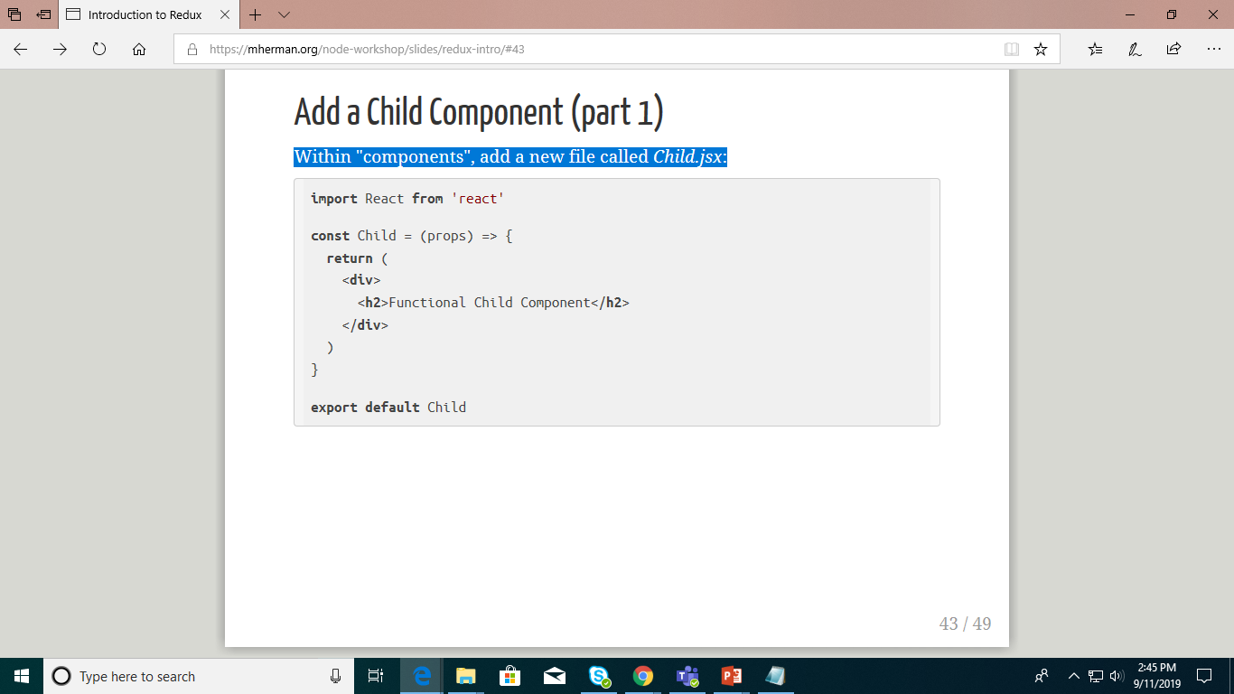
Add a Child Component
Within "components", add a new file called Child.jsx:

Slide 27
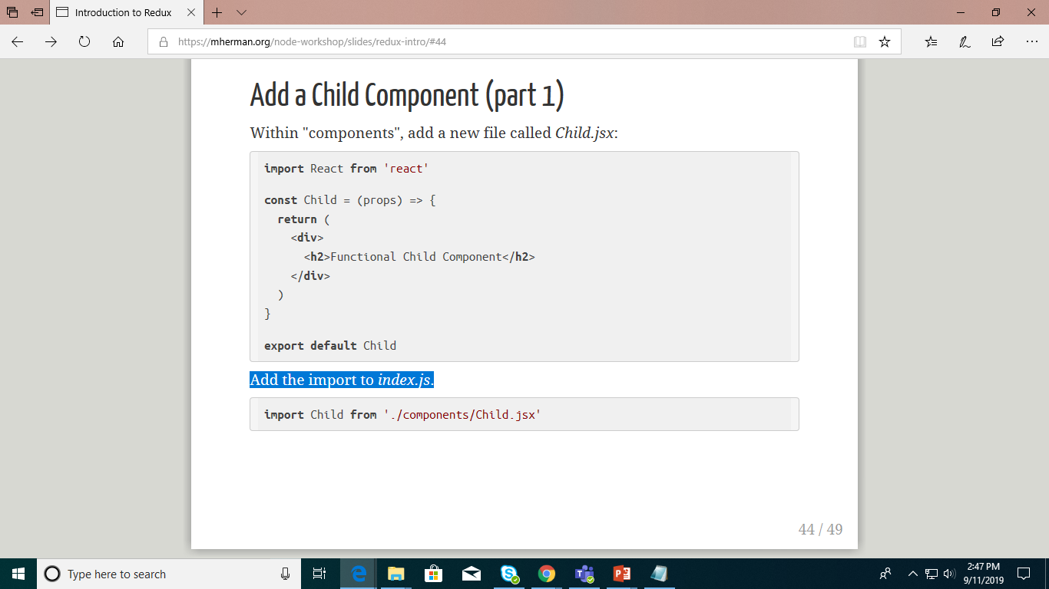
Add a Child Component
Add the import to index.js.
Add <Child/> to the render function, just below the button.

Slide 28
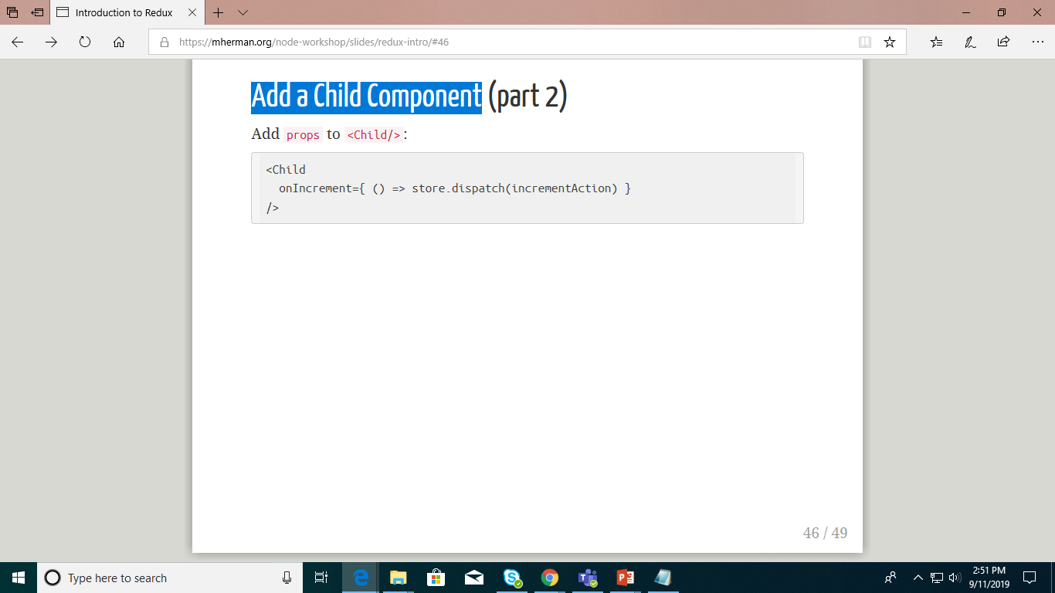
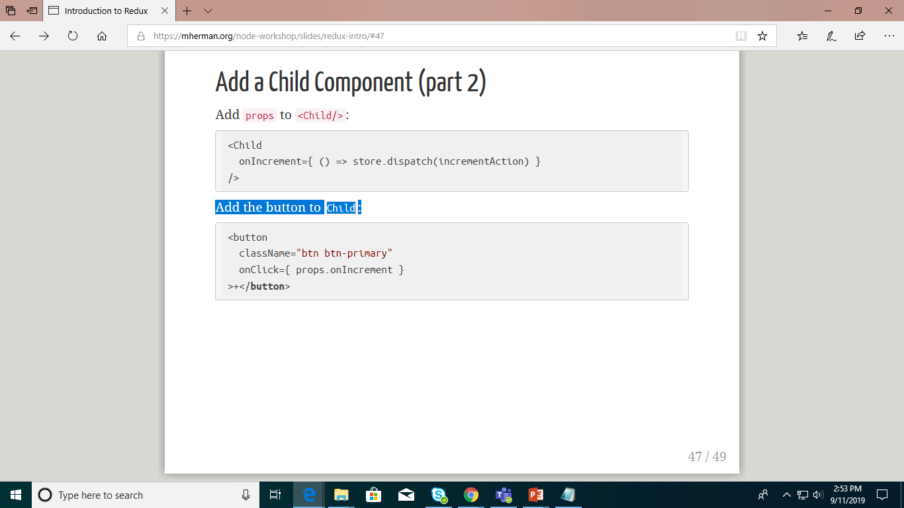
Add a Child Component
Add the button to Child:
YOUR TURN! You've seen this all before. Review it with your neighbor.

